Slide 1
SchoolPlus
helps students to do their homework and prepare for their classes
Yoana Stankova, Kaloyan Yanchev
y.stankova22@acsbg.org, k.yanchev22@acsbg.org
American College in Sofia

Slide 2
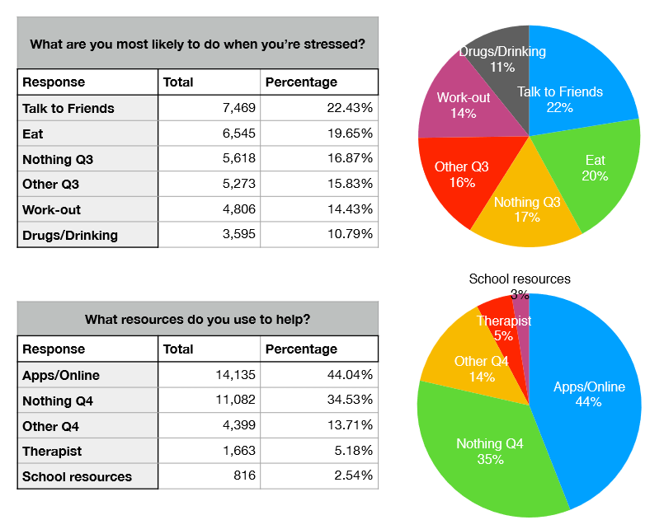
Problem - Amount of Workload

Slide 3
Solution - Studying Optimization

Slide 4
DESKTOP PROJECT
Show and explain your web, app or software projects using these gadget templates.
Place your screenshot here

Slide 5




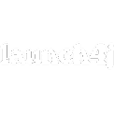




Technologies

Slide 6
Features
One time installation
Offline
All subjects in one place
Tools that optimize studying

Slide 7
Benefits
Studying anywhere with an access to a computer
No need of any external tools
Saving time

Slide 8
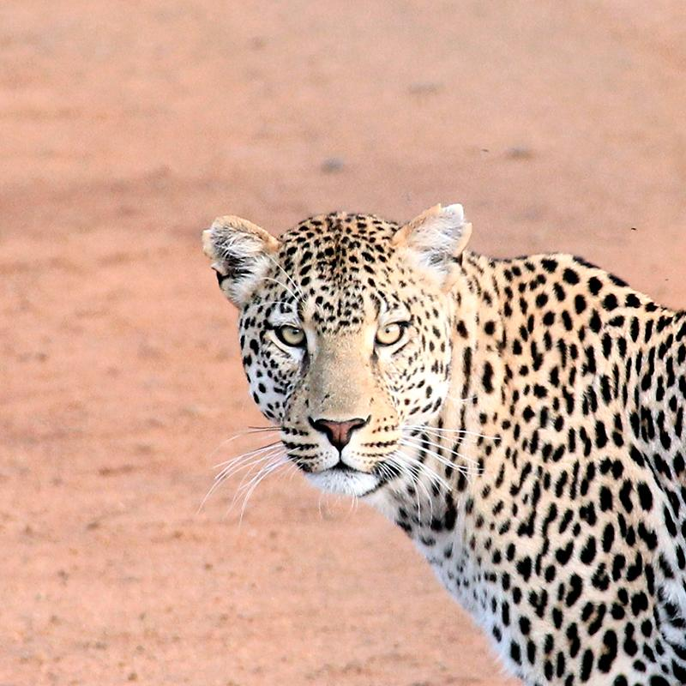
Hello world!
I AM JAYDEN SMITH
I am here because I love to give presentations.
You can find me at:
@username

Slide 9
1
TRANSITION HEADLINE
Let’s start with the first set of slides

Slide 10
Quotations are commonly printed as a means of inspiration and to invoke philosophical thoughts from the reader.

Slide 11
BIG CONCEPT
Bring the attention of your audience over a key concept using icons or illustrations

Slide 12
YOU CAN ALSO SPLIT YOUR CONTENT
Black
Is the color of coal, ebony, and of outer space. It is the darkest color, the result of the absence of or complete absorption of light.

Slide 13
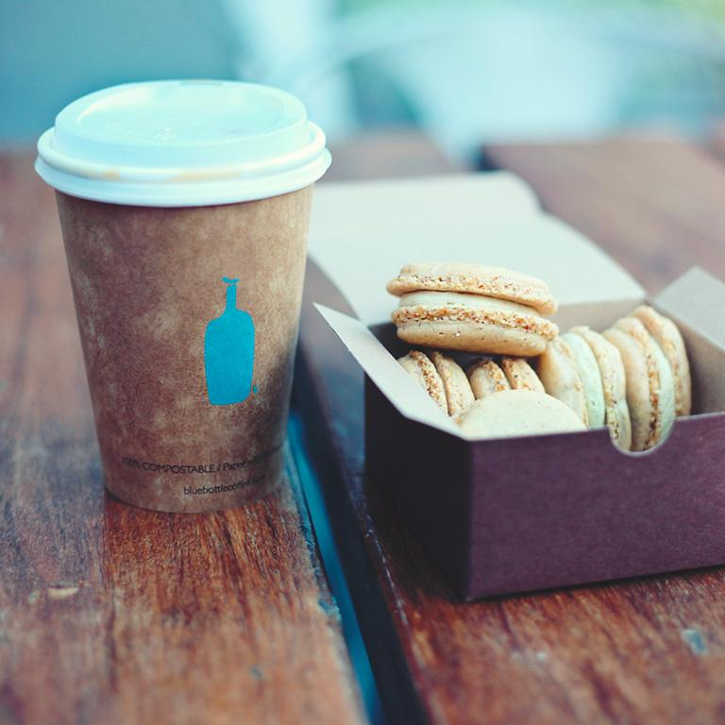
A PICTURE IS WORTH A THOUSAND WORDS
A complex idea can be conveyed with just a single still image, namely making it possible to absorb large amounts of data quickly.

Slide 14
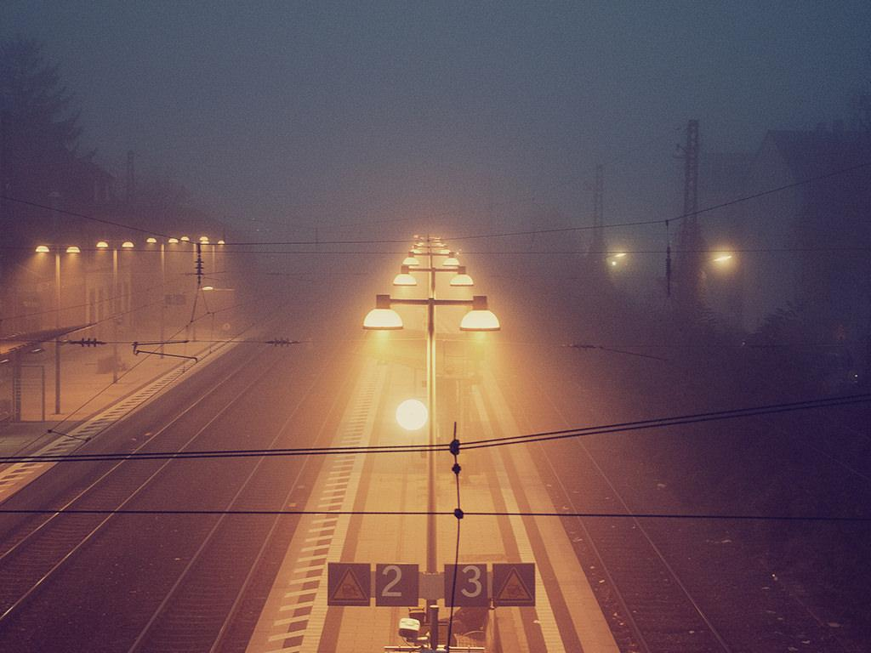
Want big impact?
USE BIG IMAGE

Slide 15
USE CHARTS TO EXPLAIN YOUR IDEAS
White
Gray
Black

Slide 16
AND TABLES TO COMPARE DATA
 | A | B | C
Yellow | 10 | 20 | 7
Blue | 30 | 15 | 10
Orange | 5 | 24 | 16

Slide 17

MAPS
our office

Slide 18
89,526,124
Whoa! That’s a big number, aren’t you proud?

Slide 19
89,526,124$
185,244 users
100%
That’s a lot of money
And a lot of users
Total success!

Slide 20
OUR PROCESS IS EASY
first
second
last

Slide 21
LET’S REVIEW SOME CONCEPTS
Yellow
Is the color of gold, butter and ripe lemons. In the spectrum of visible light, yellow is found between green and orange.
Blue
Is the colour of the clear sky and the deep sea. It is located between violet and green on the optical spectrum.
Red
Is the color of blood, and because of this it has historically been associated with sacrifice, danger and courage.
Yellow
Is the color of gold, butter and ripe lemons. In the spectrum of visible light, yellow is found between green and orange.
Blue
Is the colour of the clear sky and the deep sea. It is located between violet and green on the optical spectrum.
Red
Is the color of blood, and because of this it has historically been associated with sacrifice, danger and courage.

Slide 22
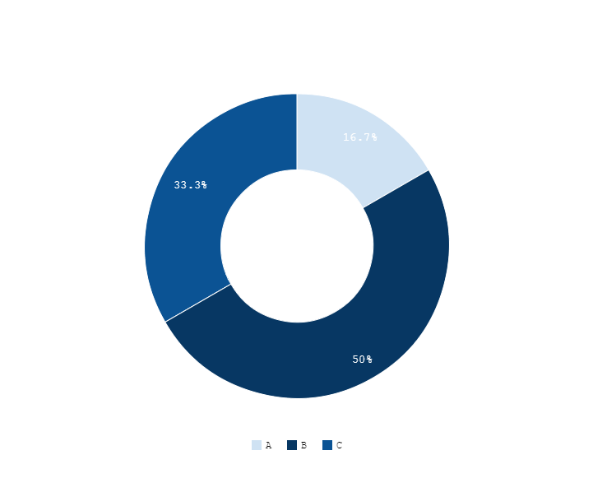
You can copy&paste graphs from Google Sheets

Slide 23
ANDROID PROJECT
Show and explain your web, app or software projects using these gadget templates.
Place your screenshot here

Slide 24
iPHONE PROJECT
Show and explain your web, app or software projects using these gadget templates.
Place your screenshot here

Slide 25
TABLET PROJECT
Show and explain your web, app or software projects using these gadget templates.
Place your screenshot here

Slide 26
Thanks!
ANY QUESTIONS?
You can find me at:
@username user@mail.me

Slide 27
Sources
https://www.google.bg/url?sa=i&source=images&cd=&cad=rja&uact=8&ved=2ahUKEwj8lLTH6vbeAhUHU1AKHfAzBioQjRx6BAgBEAU&url=https%3A%2F%2Fianskerrett.wordpress.com%2F2013%2F12%2F17%2Fupdate-on-new-logo-designs%2F&psig=AOvVaw3afaansw5XKFIiKobQW4bY&ust=1543485711032793

Slide 28
Presentation design
This presentations uses the following typographies:
Titles & Body copy: Cousine
You can download the fonts on this page:
https://www.fontsquirrel.com/fonts/cousine
You don’t need to keep this slide in your presentation. It’s only here to serve you as a design guide if you need to create new slides or download the fonts to edit the presentation in PowerPoint®

Slide 29
SlidesCarnival icons are editable shapes.
This means that you can:
Resize them without losing quality.
Change fill color and opacity.
Isn’t that nice? :)
Examples:

Slide 30
😉
Now you can use any emoji as an icon!
And of course it resizes without losing quality and you can change the color.
How? Follow Google instructions https://twitter.com/googledocs/status/730087240156643328
✋👆👉👍👤👦👧👨👩👪💃🏃💑❤😂😉😋😒😭👶😸🐟🍒🍔💣📌📖🔨🎃🎈🎨🏈🏰🌏🔌🔑 and many more...

